Slide 1
Autoencoders

Slide 2
What is an Autoencoder?
An autoencoder is a type of neural network designed to learn an efficient, compressed representation of input data in an unsupervised way.
It consists of two main parts:
  Encoder: Compresses the input data into a lower-dimensional space (called the latent space or code).
  Decoder: Reconstructs the input data from this compressed representation.

Slide 3



Slide 4
The goal of an autoencoder is to minimize the difference between the original input and its reconstruction by learning the most important features in the data.
They are essentially neural networks that are designed to reconstruct their input data as closely as possible. The ability to reconstruct the input is a way to ensure that the autoencoder is learning meaningful and useful representations of the data.
Autoencoders are primarily used for compression.

Slide 5
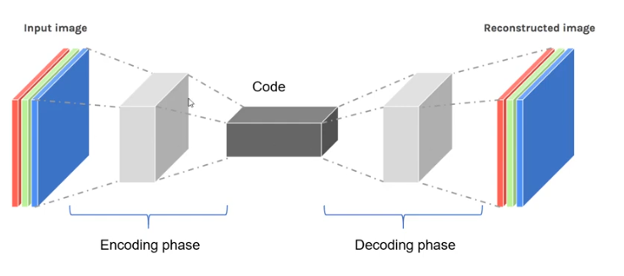

Slide 6
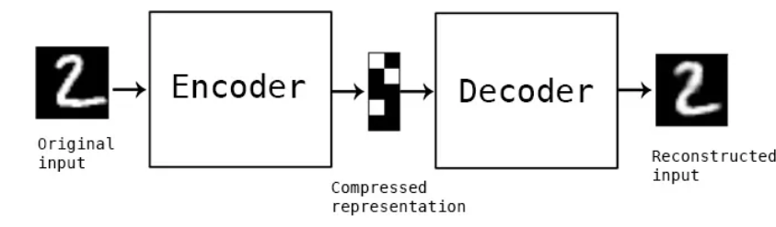

Slide 7
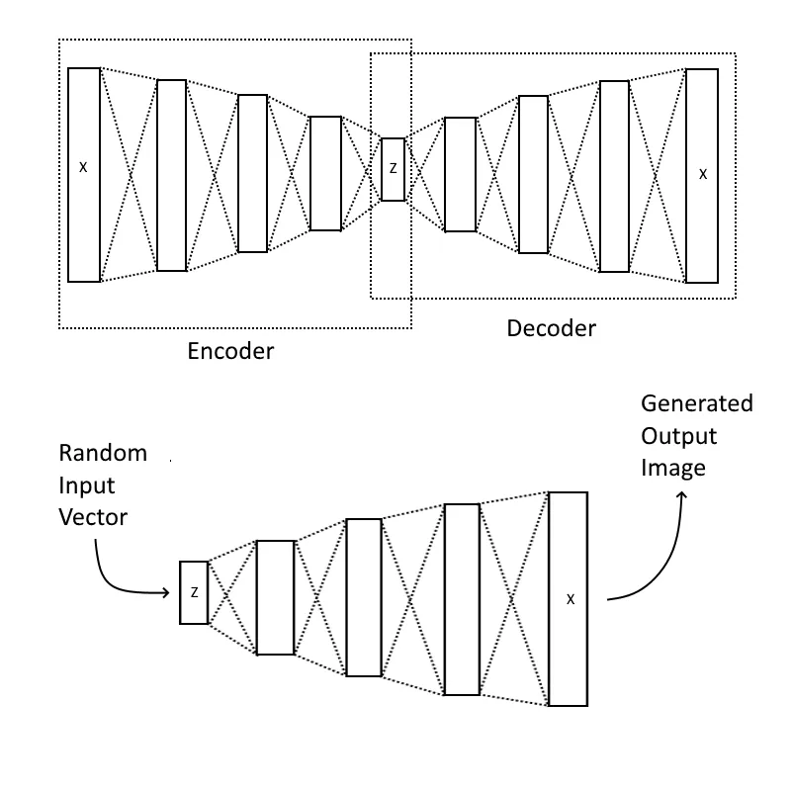

Slide 8
Bottleneck Layer
The most important part of the neural network, and ironically the smallest one, is the bottleneck. The bottleneck exists to restrict the flow of information to the decoder from the encoder, thus, allowing only the most vital information to pass through.
Since the bottleneck is designed in such a way that the maximum information possessed by an image is captured in it, we can say that the bottleneck helps us form a knowledge-representation of the input.
Thus, the encoder-decoder structure helps us extract the most from an image in the form of data and establish useful correlations between various inputs within the network.

Slide 9
Bottleneck Layer
A bottleneck as a compressed representation of the input further prevents the neural network from memorizing the input and overfitting on the data.
As a rule of thumb, remember this: The smaller the bottleneck, the lower the risk of overfitting.
However— Very small bottlenecks would restrict the amount of information storable, which increases the chances of important information slipping out through the layers of the encoder.

Slide 10
Need for Autoencoders
Efficient Representation Learning & Dimensionality Reduction
The High-dimensional data, like images or audio, contains many variables. However, the most useful information is often concentrated in fewer dimensions.
Traditional methods like Principal Component Analysis have limitations in capturing non-linear relationships in data.
Solution: Autoencoders help learn efficiently by lower-dimensional representations of data in an unsupervised manner by encoding the essential features, making subsequent tasks (e.g., classification, regression) easier and faster.

Slide 11
Need for Autoencoders
Unsupervised Feature Learning
Deep learning models often require a large amount of labeled data, which is difficult and expensive to obtain.
Solution: Autoencoders can learn useful features from unlabeled data in an unsupervised manner. These features can then be applied to various downstream tasks such as classification or clustering.

Slide 12
Need for Autoencoders
Initialization of Deep Networks
Training deep networks from scratch was historically difficult due to issues like vanishing/exploding gradients.
Solution: Autoencoders, especially in the form of stacked autoencoders, were used to initialize deep networks layer by layer, a process called pretraining. This allowed networks to start with a good initialization before fine-tuning with supervised learning.

Slide 13
Need for Autoencoders
Data Denoising and Preprocessing
Real-world data is often noisy or incomplete, which affects the performance of machine learning models.
Solution: Denoising autoencoders can learn to recover clean data from noisy input, improving data quality for subsequent tasks.

Slide 14
Need for Autoencoders
Data Compression Problem
Storing and transmitting large volumes of data (e.g., images, videos) is resource-intensive.
Solution: Autoencoders provide a means of compressing data into a lower-dimensional space (latent code) that can be used for efficient storage and transmission, without significant loss of important information.

Slide 15
Need for Autoencoders
Regularization
To prevent autoencoders from learning a trivial identity function (simply copying the input to the output without learning meaningful features), regularization techniques are often applied:
  Sparsity: Encouraging the latent code to contain mostly zeros, leading to sparse activations.
  Denoising: Adding noise to the input and training the autoencoder to remove the noise, improving the robustness of the learned representation (denoising autoencoders).
  Weight Decay or Dropout: Techniques to prevent overfitting and ensure the autoencoder generalizes well to unseen data.

Slide 16
Autoencoder Architecture
Input Layer (X): Original high-dimensional data.
Encoder: Neural network layers (e.g., dense layers, convolutional layers) that transform the input into the latent space.
Latent Space (Z): The compressed, lower-dimensional representation of the input.
Decoder: Neural network layers that take the latent space as input and attempt to reconstruct the original input.
Output Layer (X'): The final reconstructed data, aiming to be as close as possible to the input.

Slide 17
Autoencoder Architecture
Loss Function
The network is trained to minimize the reconstruction loss—the difference between the input (X) and the output (X’).
For continuous data, this is typically the mean squared error (MSE), and for categorical data, cross-entropy loss may be used.

Slide 18
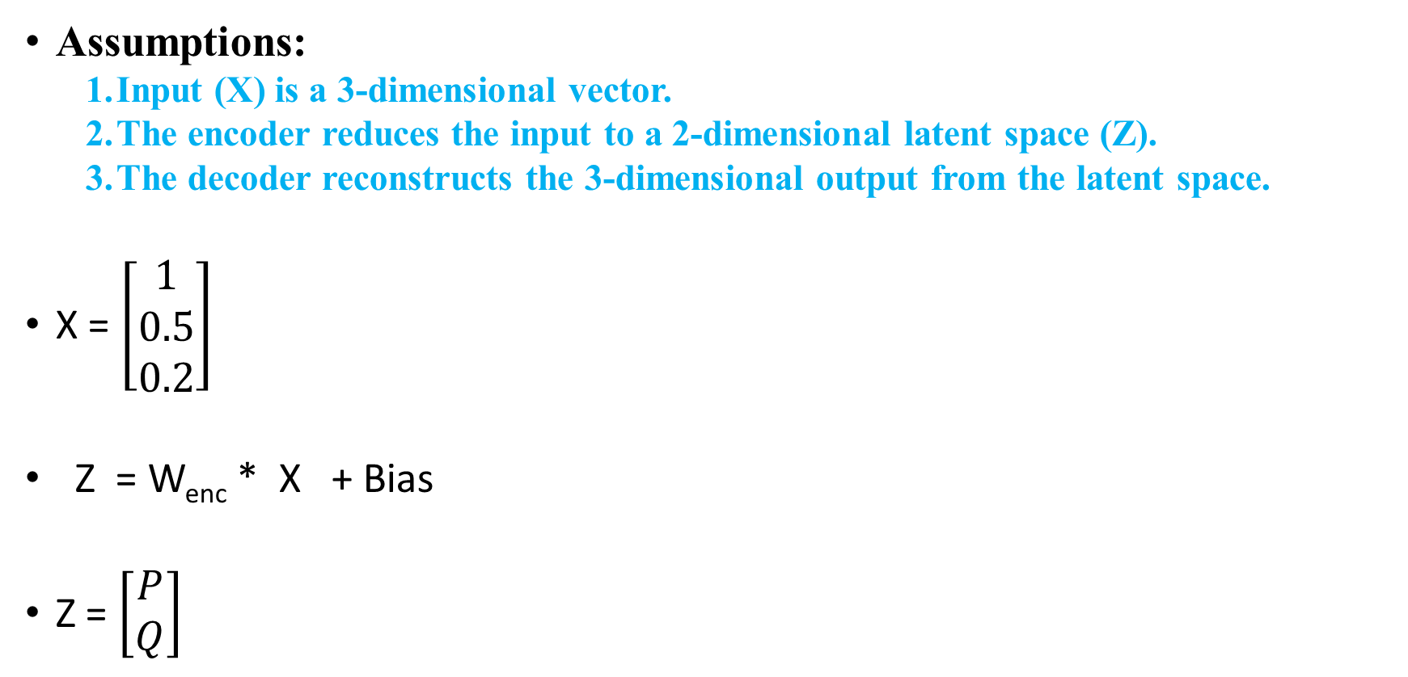
Numerical Example
Assumptions:
  Input (X) is a 3-dimensional vector.
  The encoder reduces the input to a 2-dimensional latent space (Z).
  The decoder reconstructs the 3-dimensional output from the latent space.
X = $\left[\begin{aligned}1 \\ 0.5 \\ 0.2\end{aligned}\right]$
Z = W_{enc} * X + Bias
Z = $\left[\begin{aligned}P \\ Q\end{aligned}\right]$

Slide 19
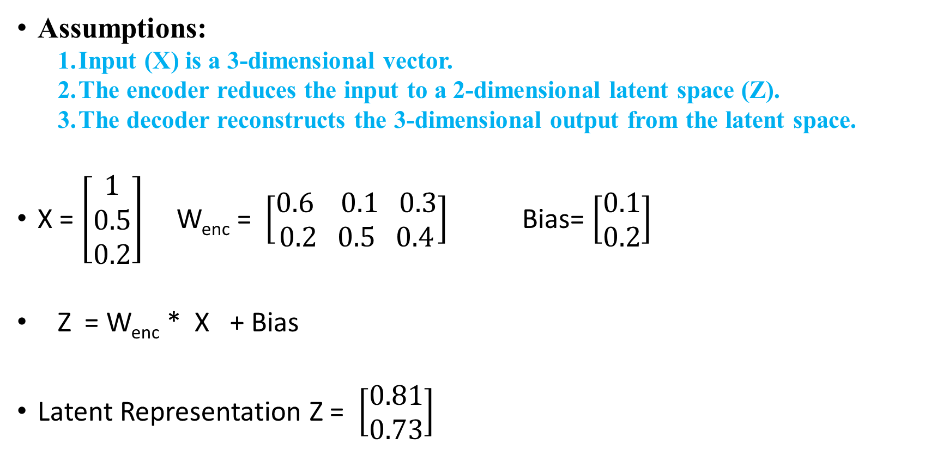
Numerical Example
Assumptions:
  Input (X) is a 3-dimensional vector.
  The encoder reduces the input to a 2-dimensional latent space (Z).
  The decoder reconstructs the 3-dimensional output from the latent space.
X = $\left[\begin{aligned}1 \\ 0.5 \\ 0.2\end{aligned}\right]$ W_{enc} = $\left[\begin{aligned}0.6 0.1 0.3 \\ 0.2 0.5 0.4\end{aligned}\right]$ Bias= $\left[\begin{aligned}0.1 \\ 0.2\end{aligned}\right]$
Z = W_{enc} * X + Bias
Latent Representation Z = $\left[\begin{aligned}0.81 \\ 0.73\end{aligned}\right]$

Slide 20

Decoder
W_{dec} = $\left[\begin{aligned}0.5 0.3 \\ 0.4 0.2 \\ 0.6 0.1\end{aligned}\right]$ Bias_{dec}= $\left[\begin{aligned}0.2 \\ 0.1 \\ 0.3\end{aligned}\right]$
Decoder Operation
X’ =W_{dec}​ * Z + Bias_{dec}​
X’ = = $\left[\begin{aligned}0.824 \\ 0.57 \\ 0.859\end{aligned}\right]$

Slide 21
Types of Autoencoders
Undercomplete Autoencoders
Overcomplete Auto encoders
Regularized Autoencoders
  Sparse autoencoders
  Denoising autoencoder
  Contractive autoencoders
Stochastic Encoders and Decoders

Slide 22
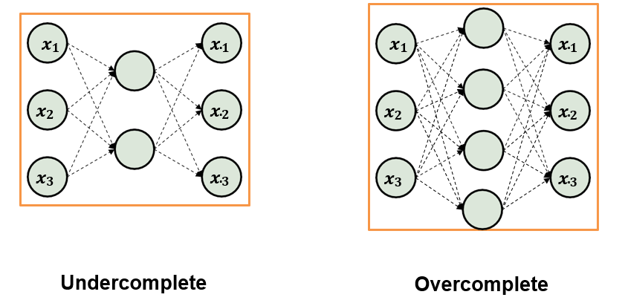
For Undercomplete autoencoder - output dimension of encoder is smaller than input dimension and
vice versa for Overcomplete autoencoder

Slide 23
Architecture
UNDERCOMPLETE AUTOENCODER
OVERCOMPLETE AUTOENCODER
Latent space is smaller than the input space.
The bottleneck layer forces the model to learn compressed, essential features from the data by reducing its dimensionality.
For example, for an input of size 100 dimensions, the latent space might be 20 dimensions.
Latent space is larger than the input space.
The bottleneck layer has more neurons than the input, allowing the model to potentially learn a more complex or redundant representation of the data.
For example, for an input of size 100 dimensions, the latent space might be 200 dimensions.

Slide 24
Feature Extraction
UNDERCOMPLETE AUTOENCODER
OVERCOMPLETE AUTOENCODER
Compression: The goal is to capture the most important or relevant information in a compressed form by reducing dimensionality. The smaller latent space forces the model to focus on the core structure of the data, discarding noise or redundancy.
Minimal Redundancy: The limited number of latent dimensions prevents the model from simply copying the input; it must encode meaningful features.
Potential for Redundancy: Because the latent space is larger, the model has the capacity to "memorize" or learn an identity mapping of the input unless it is constrained.
Need for Regularization: Without techniques like sparsity, denoising, or contractive penalties, the model may just pass the input through without learning useful features. This is not desired unless specific regularization is applied.

Slide 25
Risk of Identity Mapping
UNDERCOMPLETE AUTOENCODER
OVERCOMPLETE AUTOENCODER
High Risk of Identity Mapping: Without regularization, an overcomplete autoencoder can easily learn to just replicate the input at the output, failing to extract meaningful features or reduce dimensionality.
Need for Regularization: Techniques like sparsity or denoising must be introduced to force the model to learn useful, generalized features rather than a direct copy of the input.
Low Risk: The reduced dimensionality naturally prevents identity mapping (i.e., copying input to output). The network is constrained by the small latent space and must learn efficient representations.
Better Generalization: It’s more likely to capture general patterns or features that apply across the input data, as it doesn’t have enough capacity to memorize every detail of the data.

Slide 26
Training and Learning Process
UNDERCOMPLETE AUTOENCODER
OVERCOMPLETE AUTOENCODER
Compression-Driven Learning: The encoder learns to project the input data into a lower-dimensional latent space that preserves as much important information as possible.
Reconstruction: The decoder attempts to reconstruct the input from this compressed latent representation, minimizing the reconstruction loss (e.g., mean squared error) between the input and output.
Regularization-Driven Learning: Since the latent space is larger, the model needs additional constraints to prevent it from merely copying the input. Regularization like sparsity or adding noise forces the model to focus on learning abstract or high-level patterns.
Reconstruction: Similar to an undercomplete autoencoder, the decoder reconstructs the input, but the training dynamics are different due to the use of regularization techniques.

Slide 27
Use Cases
UNDERCOMPLETE AUTOENCODER
OVERCOMPLETE AUTOENCODER
Dimensionality Reduction: Commonly used for compressing data to a lower-dimensional space, similar to PCA but with the ability to capture non-linear relationships.
Feature Learning: Useful for discovering the most salient features in the data, especially in applications where the data is high-dimensional.
Richer Feature Extraction: Can learn more complex, detailed representations if properly regularized, which can be beneficial for certain tasks like image generation or anomaly detection.
Data Reconstruction and Generation: Often used in tasks that require the model to capture fine-grained details or variations in the input data.

Slide 28
Regularization Needs
UNDERCOMPLETE AUTOENCODER
OVERCOMPLETE AUTOENCODER
No Additional Regularization Needed: The small latent space size acts as a built-in constraint, preventing overfitting and identity mapping.
Requires Regularization:
Regularization is needed to prevent identity mapping. Techniques such as:
  Sparsity: Encourages only a few neurons in the latent space to activate.
  Denoising: Trains the model to reconstruct clean inputs from noisy versions.
  Contractive Penalty: Encourages robustness by penalizing the sensitivity of the latent representation to input variations.

Slide 29
Regularized Autoencoder
A Regularized Autoencoder is a type of autoencoder designed to prevent overfitting by adding a regularization term to the loss function or by modifying the architecture to impose certain constraints on the encoded representations.
The regularization helps the model learn meaningful, compact representations of the data by discouraging it from simply copying the input to the output without extracting useful features.

Slide 30
Regularized Autoencoder
A regularized autoencoder can be nonlinear and overcomplete but still learn something useful about the data distribution.
To properly train a Regularized autoencoder, we choose loss functions that help the model to learn better and capture all the essential features of the input data.
Three types of Regularized autoencoder:
  Sparse Autoencoder
  Denoising Autoencoder
  Contractive Autoencoder

Slide 31

L1 Regularization in Autoencoders
L1 regularization adds a penalty proportional to the absolute values of the weights.
When applied to the autoencoder’s weights, it tends to encourage sparsity in the model by driving some weights to zero.
This helps in feature selection and forces the autoencoder to learn a sparse encoding of the input data.
  Reconstruction Loss is usually the mean squared error or cross-entropy between the input and the reconstructed output.
  W_{i​} are the model’s weights.
  𝜆 controls the strength of the regularization.

Slide 32

L2 Regularization in Autoencoders (Ridge)
L2 regularization adds a penalty proportional to the square of the weights, encouraging the network to minimize the magnitude of the weights rather than eliminating them completely, as L1 does.
Weight shrinkage: L2 regularization shrinks the weights towards zero, but unlike L1, it doesn’t make them exactly zero. This helps in preventing overfitting by controlling the complexity of the model.
Smooth latent representations: L2 regularization encourages smoother weight distributions, which often results in smoother latent representations, making the encoded representations more continuous and less prone to overfitting.
W_{i​} are the model’s weights.
𝜆 controls the strength of the regularization.

Slide 33
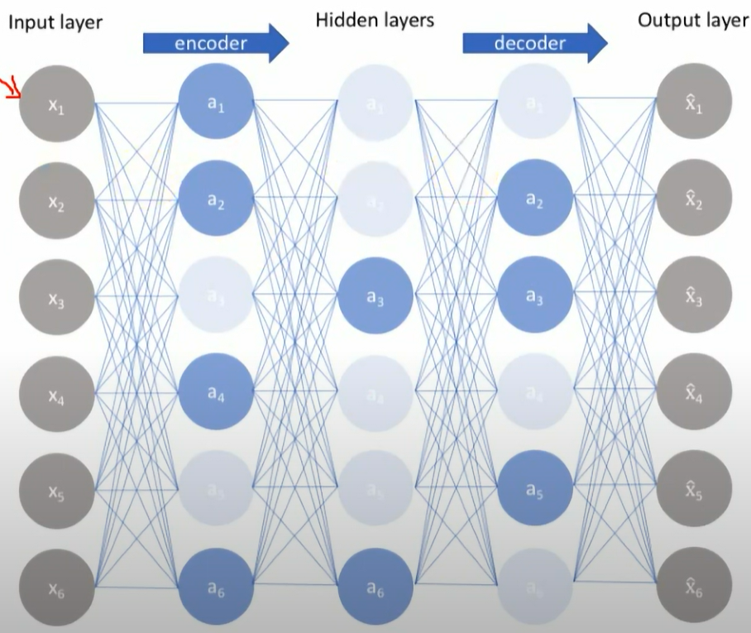
Sparse Autoencoder
Sparse autoencoders have hidden nodes greater than input nodes.
They can still discover important features from the data.
A generic sparse autoencoder is visualized where the obscurity of a node corresponds with the level of activation. Sparsity constraint is introduced on the hidden layer.
This is to prevent output layer copy input data.
Sparsity may be obtained by additional terms in the loss function during the training process, either by comparing the probability distribution of the hidden unit activations with some low desired value, or by manually zeroing all but the strongest hidden unit activations.

Slide 34
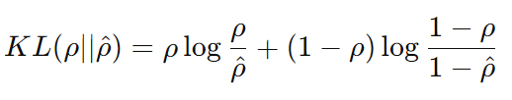

Kullback-Leibler (KL) divergence
Kullback-Leibler (KL) divergence to enforce a sparsity constraint on the hidden layer activations. This form of regularization encourages the autoencoder to learn representations where only a small subset of neurons are active for any given input, while most remain inactive.
The sparsity constraint in the hidden layer is enforced by making the average activation of each hidden neuron close to a desired value (often a small value, such as 0.05, meaning neurons are inactive most of the time).
Desired sparsity → KL divergence penalty → Regularization in the loss function

Slide 35
Kullback-Leibler (KL) divergence
Feature selection: By forcing most neurons to stay inactive, the model learns to identify the most important features in the data.
Overfitting prevention: Sparsity helps avoid overfitting by reducing the network's capacity to memorize the training data.
Efficient representation: The learned representation is often more interpretable and compact, focusing on the key factors in the input.

Slide 36
Sparse Autoencoder
Advantages
The sparsity constraint in sparse autoencoders helps in filtering out noise and irrelevant features during the encoding process.
These autoencoders often learn important and meaningful features due to their emphasis on sparse activations.
Disadvantages
The choice of hyperparameters play a significant role in the performance of this autoencoder. Different inputs should result in the activation of different nodes of the network.
The application of sparsity constraint increases computational complexity.

Slide 37
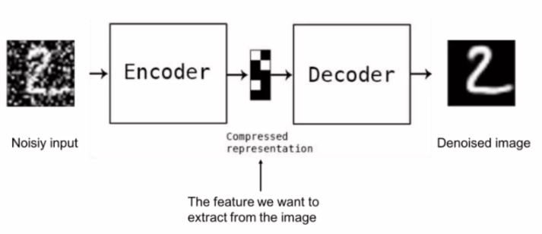
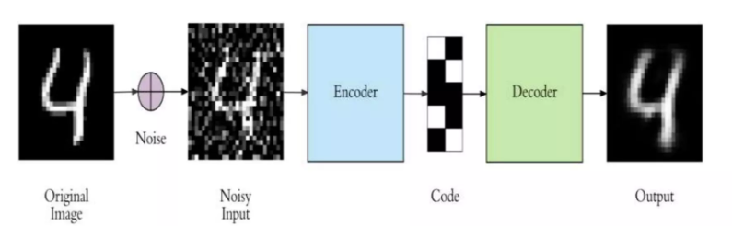
Denoising Autoencoder

Slide 38
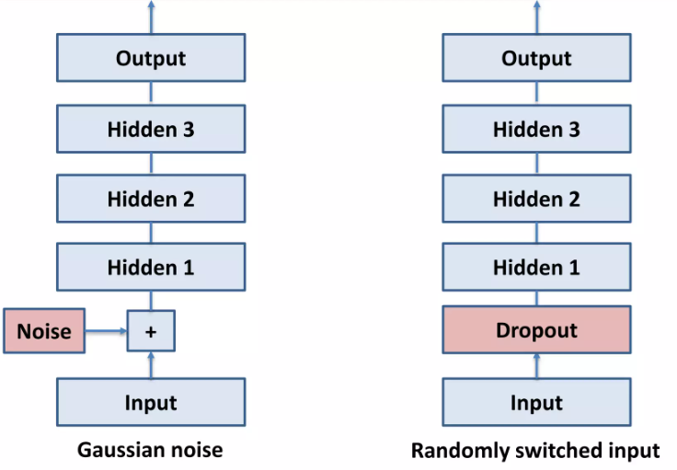
Denoising Autoencoder

Slide 39
Denoising Autoencoder
A Denoising Autoencoder (DAE) is a type of artificial neural network used primarily for unsupervised learning, especially in tasks like noise reduction, feature learning, and dimensionality reduction.
It is a variation of the standard autoencoder, but with an added objective: to reconstruct the input data from a corrupted version of it.
The idea is to teach the model to identify important features of the data that remain invariant under noise and to learn how to discard irrelevant or noisy features.

Slide 40
Denoising Autoencoder
Corrupting the Input:
  The input data is modified by introducing noise, such as:
    Gaussian noise: Adding random noise to input values.
    Salt-and-pepper noise: Randomly switching some of the input values to zero or maximum values.
    Dropout: Randomly setting some of the input features to zero.
Reconstruction:
  The autoencoder then tries to reconstruct the original clean data from the noisy data through its encoder and decoder.

Slide 41
Denoising Autoencoder
Loss Function:
The loss function typically used in training is the mean squared error (MSE) between the original input and the reconstructed input.
The network minimizes the difference between the true input and the reconstructed input after denoising.

Slide 42
Purpose of Denoising Autoencoders
Noise Robustness: Denoising autoencoders are designed to be robust against noise. This makes them useful for tasks like removing noise from images, signals, or other data types.
Feature Extraction: By learning to reconstruct data from noisy versions, the autoencoder learns useful representations (features) of the data in the latent space. These learned features can be used in downstream tasks such as classification or clustering.
Regularization: The process of adding noise acts as a regularizer, preventing the model from simply learning the identity function and thus reducing overfitting.

Slide 43
Applications
Image Denoising: Removing noise from corrupted or low-quality images.
Data Compression: Learning compact representations of high-dimensional data.
Pre-training: Denoising autoencoders can be used to initialize weights in deep neural networks before fine-tuning for a specific task.
Anomaly Detection: By learning to reconstruct clean data, they can identify anomalies in the input that deviate from the learned pattern.

Slide 44
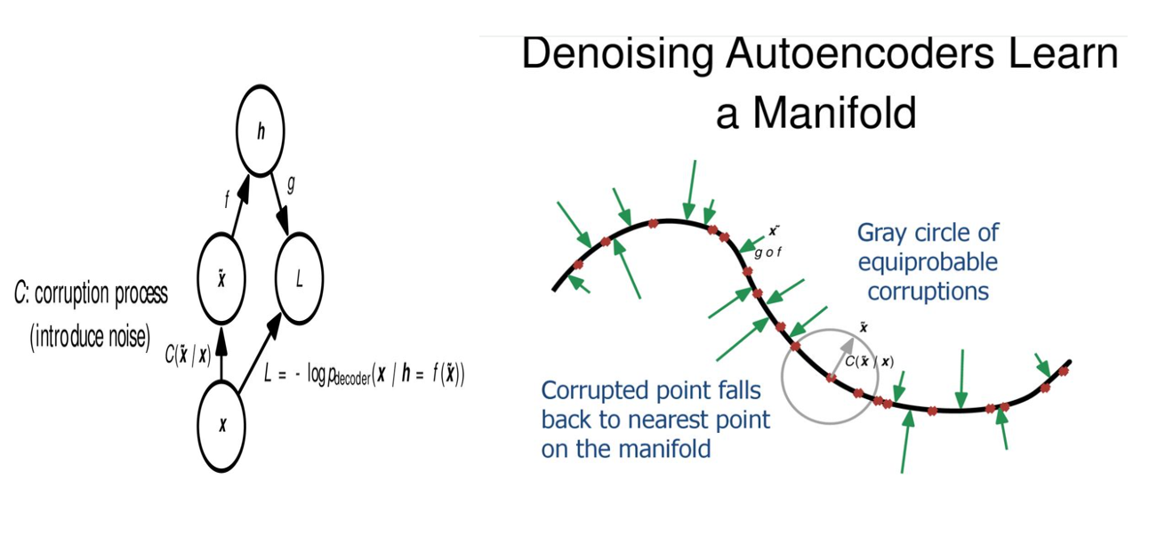

Slide 45

Corruption Process:
  The input data, denoted as x, is corrupted through a process represented as C(x̃ | x), where x̃ is the noisy version of x.
  The goal is to learn how to recover the clean input x from the corrupted version x̃.
Encoder and Decoder:
  f(x̃): The encoder function f maps the noisy input x̃ to a hidden representation h.
  g(h): The decoder function g then tries to reconstruct the clean input x from the hidden representation h.
This process is guided by minimizing the reconstruction loss
The loss L measures how well the decoder is able to reconstruct the clean input from the hidden representation of the corrupted data.

Slide 46
How they learn to map corrupted data back to the "manifold" of the original data distribution.
Manifold of Data:
In this part of the image, the black curve represents the manifold of the data—essentially the lower-dimensional space where the true data points (uncorrupted data) lie.
The goal of a denoising autoencoder is to learn this manifold. Data points close to the manifold are considered true, meaningful data.

Slide 47
Corruption and Recovery:
  The red points on the curve represent data points on the manifold.
  The gray circle surrounding a red point represents the possible noisy versions (corrupted data) of that original data point.
  The corrupted data (green arrows) can scatter in various directions, moving the point away from the manifold.
  The decoder learns to map the corrupted points (like x̃) back to the nearest point on the manifold.
  The green arrows show the network’s effort to pull these noisy points back to their original, clean locations on the manifold.

Slide 48
Denoising Objective:
  The corrupted point is projected back onto the manifold where the original data lies, ensuring that the denoising autoencoder not only removes noise but also forces the reconstruction to be close to the underlying true data distribution.
  This teaches the model to focus on the key features of the data, which remain unchanged by the corruption, making it robust to noise.

